Slide 1

Data Analysis with Azure Databricks

Slide 2
What is Azure Databricks?
Fully-managed data lake analytics platform
Based on open-source technologies
Integrated with Azure for resource management and security
Azure Databricks is a cloud-based data analytics platform that provides a unified environment for data engineering, machine learning, and analytics
Notes:
Azure Databricks is a fully managed, cloud-based data analytics platform, which empowers developers to accelerate AI and innovation by simplifying the process of building enterprise-grade data applications. Built as a joint effort by Microsoft and the team that started Apache Spark, Azure Databricks provides data science, engineering, and analytical teams with a single platform for big data processing and machine learning.
By combining the power of Databricks, an end-to-end, managed Apache Spark platform optimized for the cloud, with the enterprise scale and security of Microsoft's Azure platform, Azure Databricks makes it simple to run large-scale Spark workloads.

Slide 3
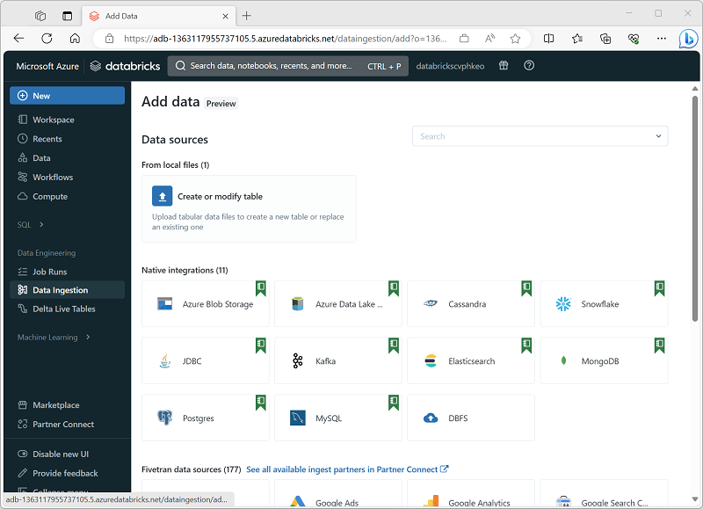
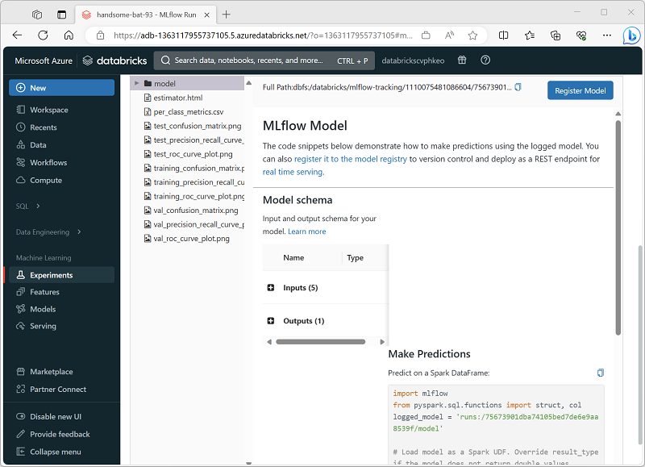
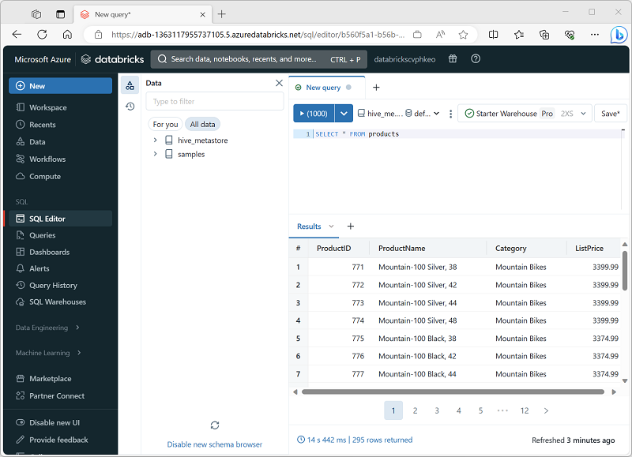
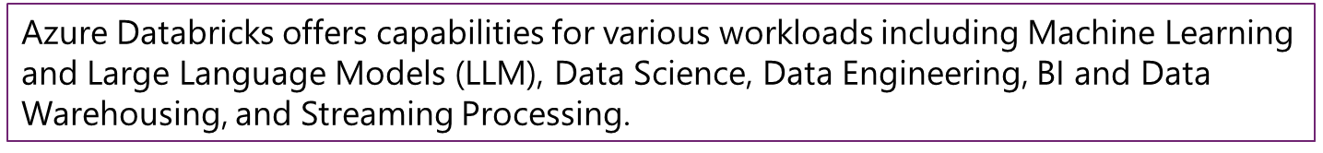
Azure Databricks workloads
Data Science and Engineering | Machine Learning | SQL
Notes:
Azure Databricks is a comprehensive platform that offers many data processing capabilities. While you can use the service to support any workload that requires scalable data processing, Azure Databricks is optimized for three specific types of data workload:
Data Science and Engineering
Machine Learning
SQL (only available in premium tier workspaces.)
The Azure Databricks user interface supports three corresponding persona views that you can switch between depending on the workload you're implementing.
Data Science and Engineering
Azure Databricks provides Apache Spark based processing and analysis of large volumes of data in a data lake. Data engineers, data scientists, and data analysts can use interactive notebooks to run code in Python, Scala, SparkSQL, or other languages to cleanse, transform, aggregate, and analyze data.
Machine Learning
Azure Databricks supports machine learning workloads that involve data exploration and preparation, training and evaluating machine learning models, and serving models to generate predictions for applications and analyses. Data scientists and ML engineers can use AutoML to quickly train predictive models, or apply their skills with common machine learning frameworks such as SparkML, Scikit-Learn, PyTorch, and Tensorflow. They can also manage the end-to-end machine learning lifecycle with MLFlow.
SQL
Azure Databricks supports SQL-based querying for data stored in tables in a SQL Warehouse. This capability enables data analysts to query, aggregate, summarize, and visualize data using familiar SQL syntax and a wide range of SQL-based data analytical tools.

Slide 4
Key concepts
Azure Databricks is a single service platform with multiple technologies that enable working with data at scale
Workspaces is an environment for accessing all the Databricks assets.
Notebooks are interactive documents that contain runnable code, visualizations, and narrative text.
Clusters are the computational engines of Azure Databricks.
Jobs are used to schedule and run automated tasks.
Databricks Runtime is a set of performance-optimized versions of Apache Spark.
Delta Lake is an open-source storage layer that brings reliability and scalability to data lakes.
Databricks SQL provides a way to perform SQL queries on the data within Azure Databricks.
MLflow is an open-source platform for managing the end-to-end machine learning lifecycle.
Notes:
Azure Databricks is a single service platform with multiple technologies that enable working with data at scale. When using Azure Databricks, there are some key concepts to understand.
Workspaces
A workspace is an environment for accessing all the Databricks assets. It provides a user interface to manage notebooks, libraries, and experiments. Workspaces can be organized into folders and shared among team members, facilitating collaboration and resource management.
Notebooks
Databricks notebooks are interactive documents that contain runnable code, visualizations, and narrative text. They support multiple languages, including Python, R, Scala, and SQL, which can be used simultaneously within the same notebook. Notebooks are central to collaborative projects and are ideal for exploratory data analysis, data visualization, and complex data workflows.
Clusters
Clusters are the computational engines of Azure Databricks. Users can create and scale clusters according to the computational resources needed. Clusters can be configured manually or set to auto-scale based on workload. They support different types of nodes for various tasks, like driver and worker nodes, ensuring efficient resource utilization.
Jobs
Jobs in Azure Databricks are used to schedule and run automated tasks. These tasks can be notebook runs, Spark jobs, or arbitrary code executions. Jobs can be triggered on a schedule or run in response to certain events, making it easy to automate workflows and periodic data processing tasks.
Databricks Runtime
The Databricks Runtime is a set of performance-optimized versions of Apache Spark. It includes enhancements for improved performance and additional functionality beyond standard Spark, such as optimizations for machine learning workloads, graph processing, and genomics.
Delta Lake
Delta Lake is an open-source storage layer that brings reliability and scalability to data lakes. It provides ACID transactions, scalable metadata handling, and unifies streaming and batch data processing, all crucial for managing large-scale data in a consistent and fault-tolerant manner.
Databricks SQL
Databricks SQL provides a way to perform SQL queries on the data within Azure Databricks. It allows data analysts to run quick ad-hoc queries and create reports directly on big data. It includes an SQL editor, dashboards, and automatic visualization tools, making it user-friendly for those accustomed to SQL environments.
MLflow
MLflow is an open-source platform for managing the end-to-end machine learning lifecycle. It includes features for experiment tracking, model management, and deployment, helping practitioners manage and share their ML models and experiments efficiently.

Slide 5
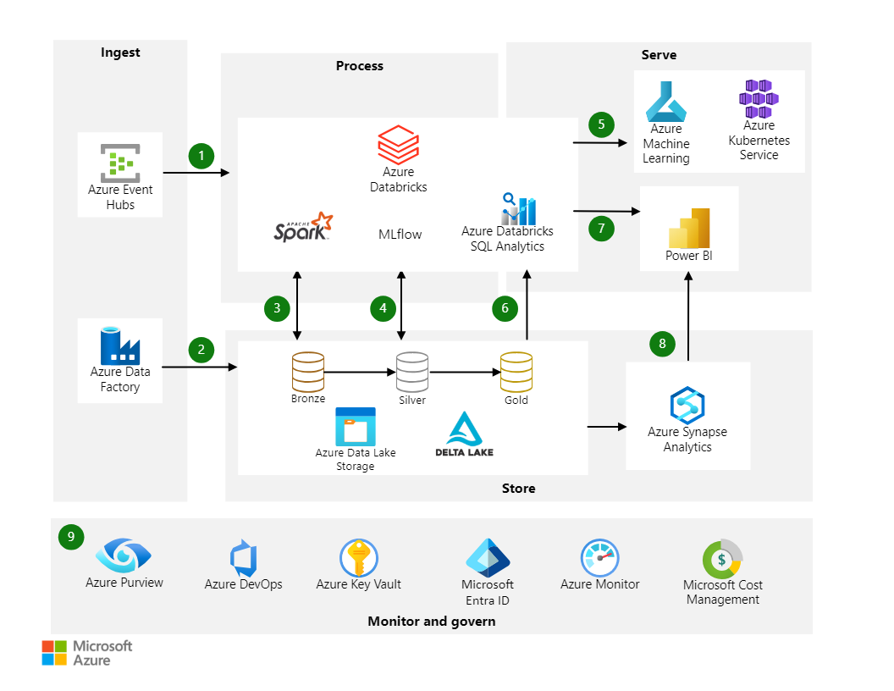
Modern analytics architecture with Azure Databricks
Notes:
https://learn.microsoft.com/en-us/azure/architecture/solution-ideas/articles/azure-databricks-modern-analytics-architecture
This solution outlines a modern data architecture. Azure Databricks forms the core of the solution. This platform works seamlessly with other services, such as Azure Data Lake Storage Gen2, Azure Data Factory, Azure Synapse Analytics, and Power BI.
Dataflow
Azure Databricks ingests raw streaming data from Azure Event Hubs.
Data Factory loads raw batch data into Data Lake Storage Gen2.
For data storage:
Data Lake Storage Gen2 houses data of all types, such as structured, unstructured, and semi-structured. It also stores batch and streaming data.
Delta Lake forms the curated layer of the data lake. It stores the refined data in an open-source format.
Azure Databricks works well with a medallion architecture that organizes data into layers:
Bronze: Holds raw data.
Silver: Contains cleaned, filtered data.
Gold: Stores aggregated data that's useful for business analytics.
The analytical platform ingests data from the disparate batch and streaming sources. Data scientists use this data for these tasks:
Data preparation.
Data exploration.
Model preparation.
Model training.
MLflow manages parameter, metric, and model tracking in data science code runs. The coding possibilities are flexible:
Code can be in SQL, Python, R, and Scala.
Code can use popular open-source libraries and frameworks such as Koalas, Pandas, and scikit-learn, which are pre-installed and optimized.
Practitioners can optimize for performance and cost with single-node and multi-node compute options.
Machine learning models are available in several formats:
Azure Databricks stores information about models in the MLflow Model Registry. The registry makes models available through batch, streaming, and REST APIs.
The solution can also deploy models to Azure Machine Learning web services or Azure Kubernetes Service (AKS).
Services that work with the data connect to a single underlying data source to ensure consistency. For instance, users can run SQL queries on the data lake with Azure Databricks SQL Analytics. This service:
Provides a query editor and catalog, the query history, basic dashboarding, and alerting.
Uses integrated security that includes row-level and column-level permissions.
Uses a Photon-powered Delta Engine to accelerate performance.
Power BI generates analytical and historical reports and dashboards from the unified data platform. This service uses these features when working with Azure Databricks:
A built-in Azure Databricks connector for visualizing the underlying data.
Optimized Java Database Connectivity (JDBC) and Open Database Connectivity (ODBC) drivers.
Users can export gold data sets out of the data lake into Azure Synapse via the optimized Synapse connector. SQL pools in Azure Synapse provide a data warehousing and compute environment.
The solution uses Azure services for collaboration, performance, reliability, governance, and security:
Microsoft Purview provides data discovery services, sensitive data classification, and governance insights across the data estate.
Azure DevOps offers continuous integration and continuous deployment (CI/CD) and other integrated version control features.
Azure Key Vault securely manages secrets, keys, and certificates.
Microsoft Entra ID provides single sign-on (SSO) for Azure Databricks users. Azure Databricks supports automated user provisioning with Microsoft Entra ID for these tasks:
Creating new users.
Assigning each user an access level.
Removing users and denying them access.
Azure Monitor collects and analyzes Azure resource telemetry. By proactively identifying problems, this service maximizes performance and reliability.

Slide 6
How to ingest data with Databricks
Event Hubs and IoT Hubs
Data pipelines with Azure Data Factory
Directly from Azure Blob Storage and Azure Data Lake
Notes:
Before you can work with data in Azure Databricks, you need to ingest data into the platform. Once in the platform, the cloud-based compute allows you to process large volumes of data efficiently.
There are multiple ways to ingest data into Azure Databricks:
Orchestrate data pipelines with Azure Data Factory
Azure Data Factory is a data integration service that allows you to create data pipelines. These pipelines can ingest data from various sources into Azure Databricks, ensuring that all your data is centralized and ready for analysis.
Ingest real-time data with Event Hubs and IoT Hubs
For real-time data ingestion, Azure Event Hubs and IoT Hubs are the most suitable choices. They enable you to stream data directly into Azure Databricks, allowing you to process and analyze data as it arrives. Real-time data ingestion and analysis is useful for scenarios like monitoring live events or tracking Internet of Things (IoT) device data.
Ingest data directly from Azure Blob Storage and Azure Data Lake
Azure Blob Storage and Azure Data Lake Storage Gen2 are perfect for storing large amounts of unstructured data.
You can easily ingest this data into Databricks using:
Databricks File System (DBFS): A distributed file system integrated with Azure Databricks, allowing you to mount Azure Blob Storage containers and access them as if they were part of the local file system.
Spark APIs: Spark APIs provide a flexible way to read and write data from Azure Blob Storage directly into Spark DataFrames, using Spark's parallel processing capabilities for efficient large-scale data processing.
DBFS offers a simpler and more integrated way to work with data in Azure Blob Storage, while Spark APIs provide greater flexibility and performance for large-scale data processing tasks. The choice between the two depends on your specific use case and requirements.

Slide 7
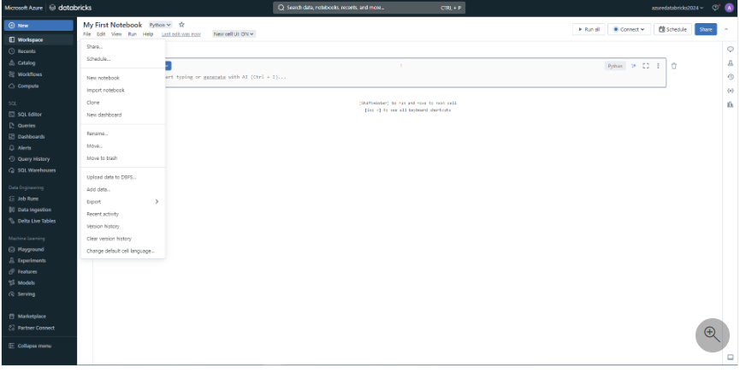
Once your data is ingested, you can explore your data to uncover actionable insights. Azure Databricks notebooks provide a collaborative environment where you can perform analysis using PySpark, Scala, R, or SQL. These notebooks aren't just powerful but also user-friendly, making it easy to manipulate and visualize your data.

Slide 8
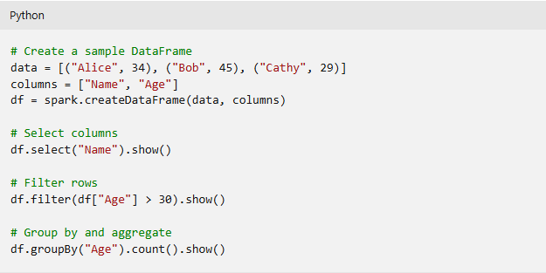
Data analysis using DataFrame APIs
When you work with data in notebooks, you make use of Spark DataFrames that are built on Apache Spark.
DataFrames allow you to manipulate large datasets efficiently. Purpose is to explore, manipulate, and analyze structured data
Two-dimensional data structure
Like a table or spreadsheet
Has functions for data analysis
Notes:
Using DataFrame APIs for data analysis is essential for efficiently exploring, manipulating, and analyzing structured data in various applications.
A DataFrame is a two-dimensional labeled data structure with columns of potentially different types. You can think of a DataFrame like a spreadsheet, a SQL table, or a dictionary of series objects.
Apache Spark DataFrames provide a rich set of functions (select columns, filter, join, aggregate) that allow you to solve common data analysis problems efficiently.
DataFrame APIs are provided by several data processing libraries, such as Pandas in Python, Apache Spark, and R's dplyr, each offering tools to handle large datasets with ease.
Working with DataFrames seems similar across libraries, but each library has some slight variations in its capabilities.
To create a simple DataFrame, you can run the following code:
DataFrames support operations like filtering, aggregation, and joining, which are crucial for data exploration.
Azure Databricks also supports SQL by allowing to switch between DataFrame operations and SQL queries to interact with the data in a way that feels most natural.
Explore data using libraries and APIs
Visualize data with external visualization tools
Besides built-in chart options, Azure Databricks integrates with external visualization tools like Tableau or Power BI through data visualization APIs for enhanced dashboarding capabilities.
Install open-source libraries
As a data analyst, data engineer, or data scientist, you can use your preferred open-source libraries to explore and process data. Azure Databricks allows you to install Python libraries such as Pandas, NumPy, or Scikit-learn for additional data analysis capabilities.
Use MLlib for machine learning workloads
You can train machine learning models to help you explore and process your data. With Spark's MLlib, you make optimal use of the distributed compute clusters that are attached to your notebooks. With the MLlib library, you can apply machine learning techniques like clustering, regression, and classification, helping you to uncover hidden and complex patterns in your data.

